Slide 1

Portfolio Project Progress Presentation
Adam Hurst
Notes:
Hello, my name is Adam, and this is my presentation on the progress I have made with portfolio final project.

Slide 2
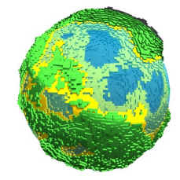
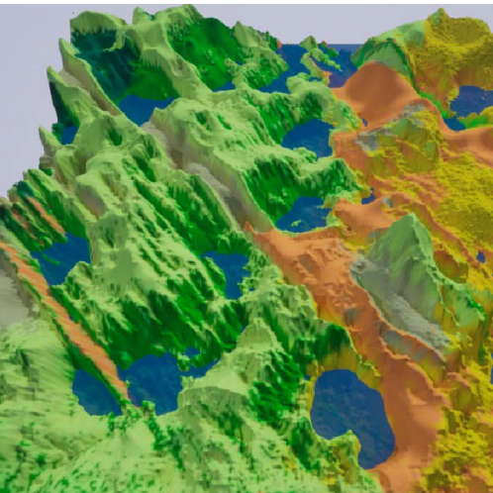
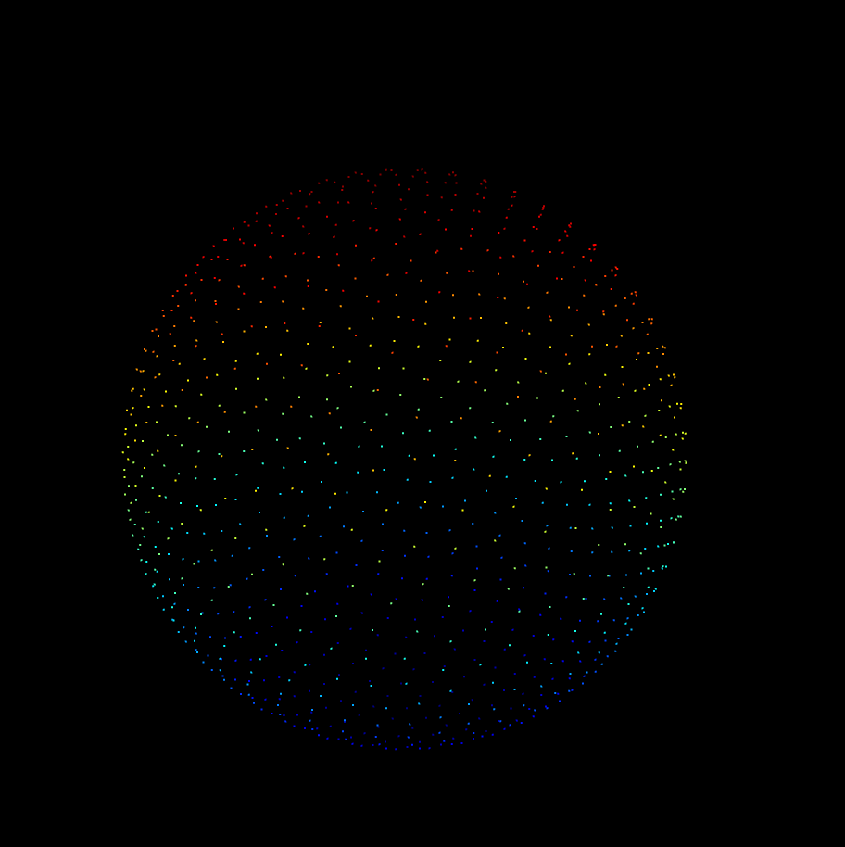
Topics
Context
Research
Progress
Plan to Completion
Notes:
As part of this presentation, I shall cover a basic description of the project, and its context within the wider research field and its importance. Then I will summarize the research I have completed thus far and explain some of the core concepts and findings I have found within this process. Afterwards I will then show my progress in the implementation, and demonstrate the current functionality. Finally I will outline my plan for completion of both the implementation and dissertation.

Slide 3

Context
Notes:
This section will explain the project, the reasons I have chosen it, and why it is important to study.

Slide 4
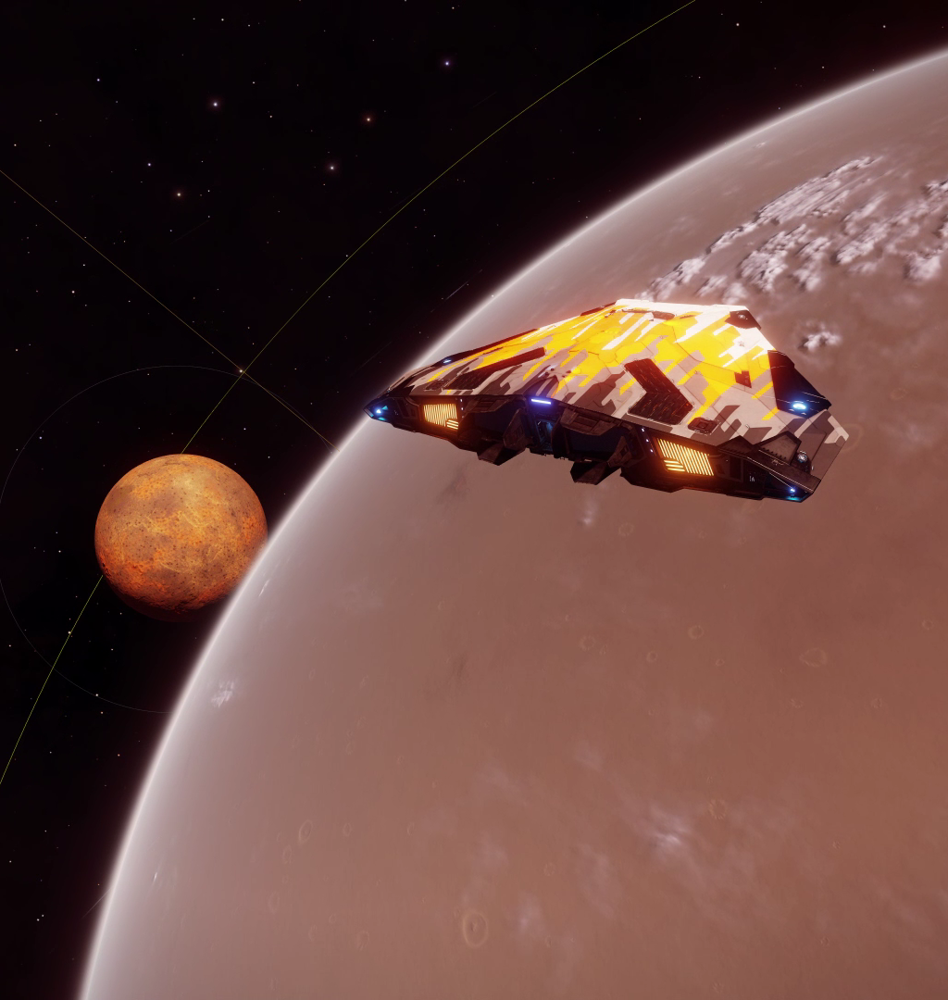
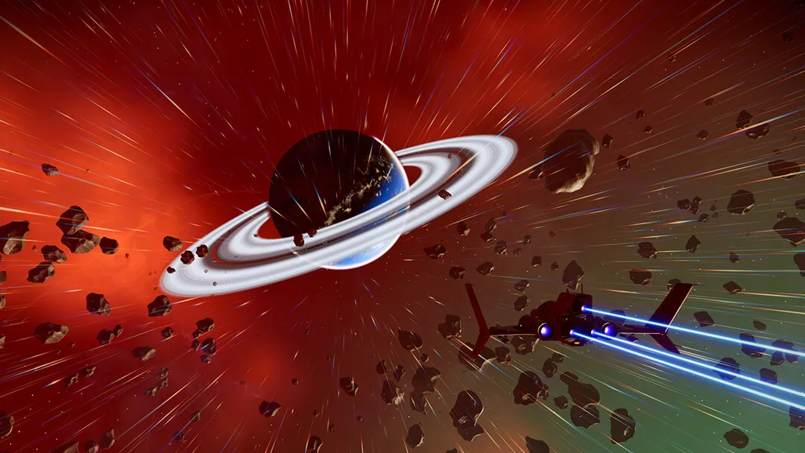
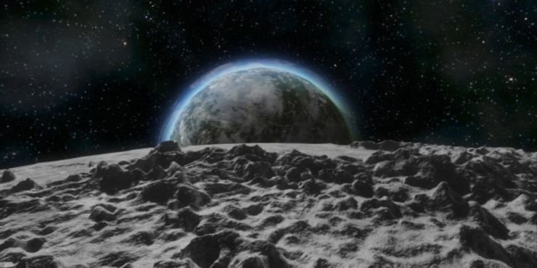
Notes:
In the gaming industry, specifically within the sci-fi genre, there is an increasing tendency to use a large amount of procedurally generated content. This approach allows for developers to create vast universes and worlds for the player to explore, either as a core gameplay concept, or as an aid in game development so that developers can focus more on gameplay features instead of world building. 3 examples shown above are some examples of procedural generation, specifically planet generation. On the left is Elite Dangerous by frontier developments, on the top right is no mans sky by hello games, and on the bottom right is space engineers from keen software house. All 3 of these games, as well as many more, have inspired my project to focus on this idea of procedural planet generation
https://bgr.com/wp-content/uploads/2018/07/no-mans-sky-next1.jpg?quality=82&strip=all
https://www.reddit.com/r/EliteDangerous/comments/mkl48g/will_we_be_able_to_land_on_planets_like_this_in/
https://www.thegamer.com/space-engineers-everything-need-know-planets/

Slide 5
Elite Dangerous
No Man’s Sky
Space Engineers
Elite Dangerous
Scale 1:1
Realistic but boring
No Man’s Sky
Incredibly diverse, interesting planets
Small, not realistically scaled planets
Space Engineers
Seamless blending between space and planets
Small, low detail planets
Notes:
For this project, I plan on combining all of the benefits of theses games into one simple product, eliminating all of the negatives as well. For example, although the scale of Elite dangerous is incredibly realistic, so is their planets. Which is good in a simulation context, but if you want to create interesting, diverse worlds to keep the player interested, this is less ideal. No mans sky on the other get this diversity very well, and all the planets are noticeably different from each other, but they suffer from the issues of being on a much smaller scale. Additionally, even though space engineers suffers from a much more restrictive generation system and their planets are much smaller, the one feature they have over both these other games is transitioning from space to the planet. Both Elite and no mans sky have a noticeable transition from space to their planets and vice versa, whereas space engineers handles this transition much better, and the experience is almost seamless.

Slide 6
Goals of Project
Create realistically sized planets
Diverse
Seamless gameplay experience
Outputs
Unity Game
Unity Package
Notes:
As a result of this first initial look at current works within the industry, I would like my final product to be a Unity package that allows for the creation of procedurally generated planets, at a user defined size, diversity through biomes.

Slide 7
Research
Notes:
For this section, I will summarize some of the major theorists and algorithms that I explored during the ongoing research process for this project.

Slide 8
Sphere Generation
Terrain Generation
Level of Detail
Atmospheric Rendering
Floating Point Precision
Main areas of Research
Notes:
There were 5 main areas of research that I wanted to look into as part of this project. Theses include, Sphere Geneation, Terrain Generation, level of detail systems, Atmospheric rendering and floating point precision errors. I will now break down all of these individual areas of study withing the next few slides of this presentation.

Slide 9
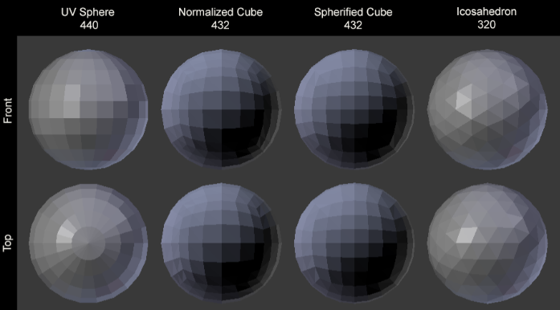
Sphere Generation
Notes:
The first major area of investigation was the best way to generate a sphere mesh. This was crucial as planets, at their core, are spheres with extra lumps. Although some planets and moons do exist that do no not follow this spherical shape, such as the moon of mars phobos, for the sake of this project’s scope, only spheres will be investigated. Initial investifation into the subject showed there were 4 well established ways to create the verticies of a sphere. These were the UV sphere, the normalized cube, the spherified cube and the icosahedron. Theses methods are the most documented algorithms I found during my research, and examples of each of these methods can be seen in the picture here

Slide 10
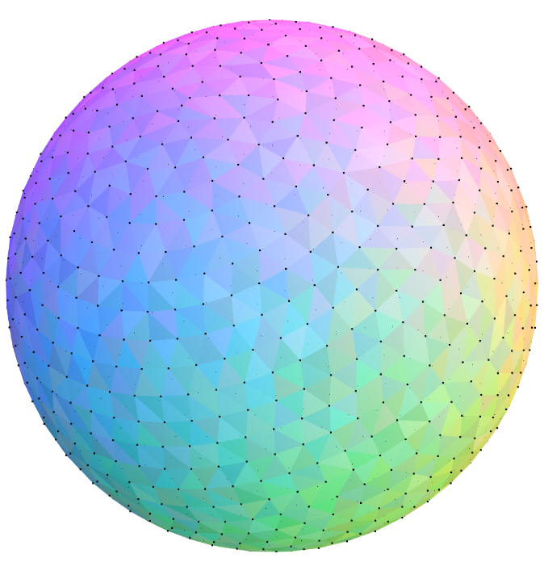
Sphere Generation
Notes:
Although these methods were good, they all suffered from a less than perfect point distribution, and this would be important to lower the chance of visual artefacts, and allow for a more constent level of detail. As such my research took me to what is known as the Fibonacci sphere. This algorithm uses the fibonnachi sphere to generate the most evenly distributed points in all of the methods researched. This method would have been perfect, if it wernt down to some major downsides. This method is much more computationally and mathematically complex to generate this sphere. The main issue arrives from trying to triangulate the generated points, as the algorithm generates the points in a non linear way, making it to complex for my understanding to triganulate. Additionly, again due to this non grid structure, it would be incredibly hard to subdivide this sphere into different terrain chunks, which is important for level of detail which will be discussed later. As such the method for implementation that I have chosen is the spherified cube, as it had good enough point distribution, whilst also being much easier to triangulate and break into chunks.

Slide 11
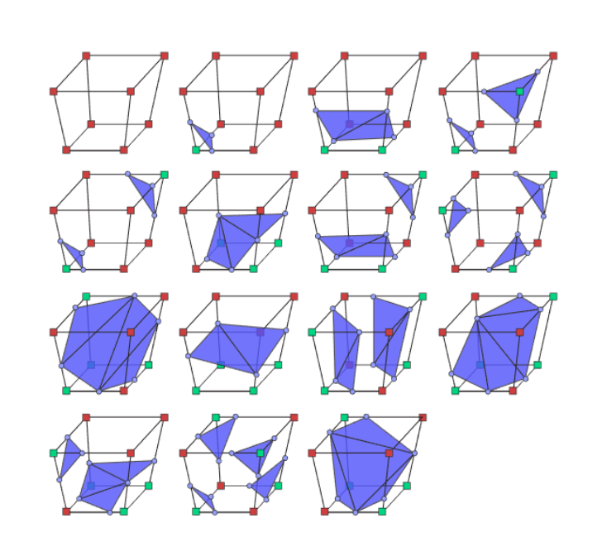
Sphere Generation
Notes:
Another area I briefly researched into was Marching Cubes. This algorithm uses voxels to create the shapes of the terrain, instead of having to manually specify the vertices of every triangle of the terrain. This was investigated, as in theory it would have allowed for deformable terrain, as well as much more advanced terrain features such as caves and overhangs. There was even a paper by Zackary P. T. Sin and Peter H. F. Ng, on a method for implementing this algorithm for a spherical space, for use within planet generation. Unfortunately, during initial testing, this algorithm proved to be far to slow for runtime operation, at least at the scale that I wanted to achive. In a future iteration of this project, I would definitely like to have another attempt at implementing this using the GPU to aide in computiation.

Slide 12
Terrain Generation

Slide 13
Progress

Slide 14
Plan to Continue

